Slide 1
5 tips for choosing the colors on your website

Slide 2


1. Content is more important than color
More subtle colors are pleasant
Too “loud” makes the content secondary to the color scheme.

Slide 3
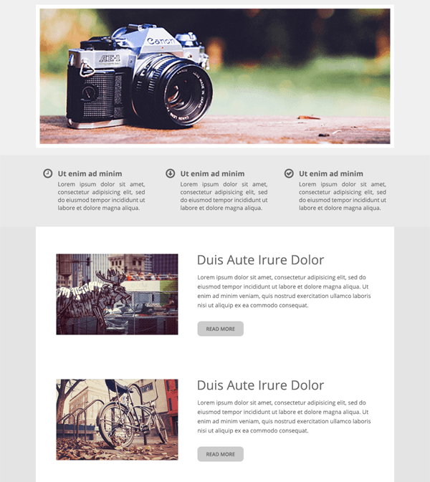
2. Gray is always safe
If you look at any selection of popular websites, templates or themes, there's a good bet a majority of them will have this exact same base of dark gray text on white or light gray. With this combination you are virtually guaranteed to provide readability for visitors, and allow the text and image based content to come into the foreground.

Slide 4
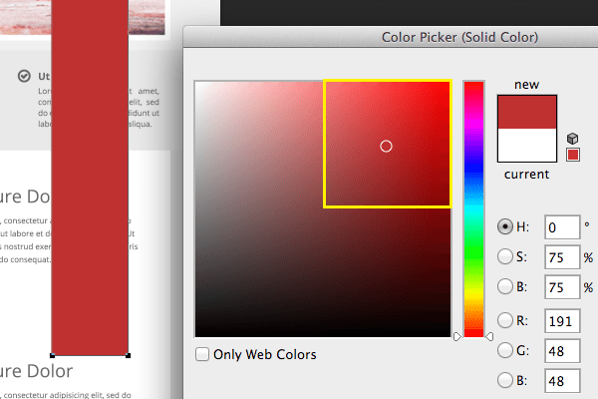
3. Choose Just One Color to Highlight
Buttons, menus and borders should share one color. The more colors you use, the trickier it gets to keep them all under control. Your highlight color can be blue, green, red or whatever you please but choose only one.

Slide 5
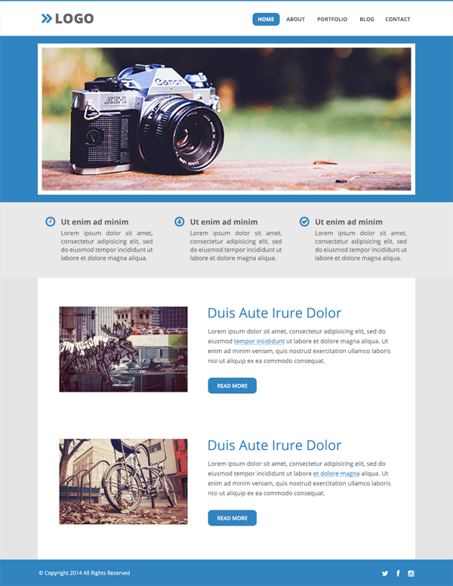
4. If in Doubt, Use Blue
Blue is often the most flexible color to work with and will fit the highest number of site types. Colors like purple and yellow can be very pleasant, but can also quickly turn garish if used in the wrong way.

Slide 6



5. Use Monochromatic Themes
You're going to need extra colors for your design, but they're all going to be variations of that one highlight color you've already chosen in order to keep things simple.

Slide 7
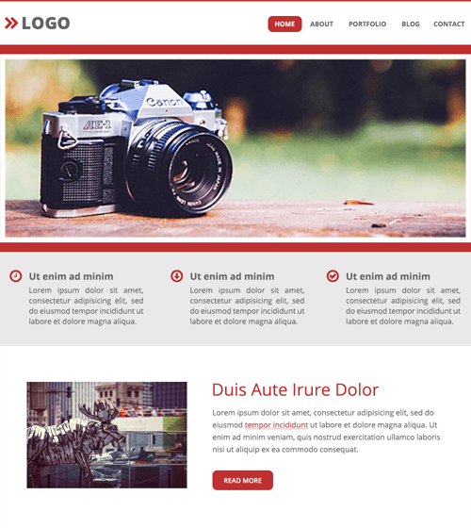
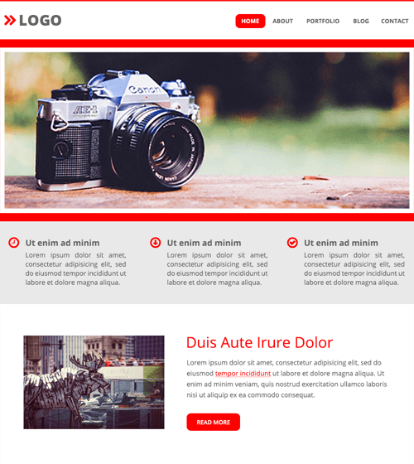
6. Stay Out of the Top Right Corner of the Color Picker

Slide 8
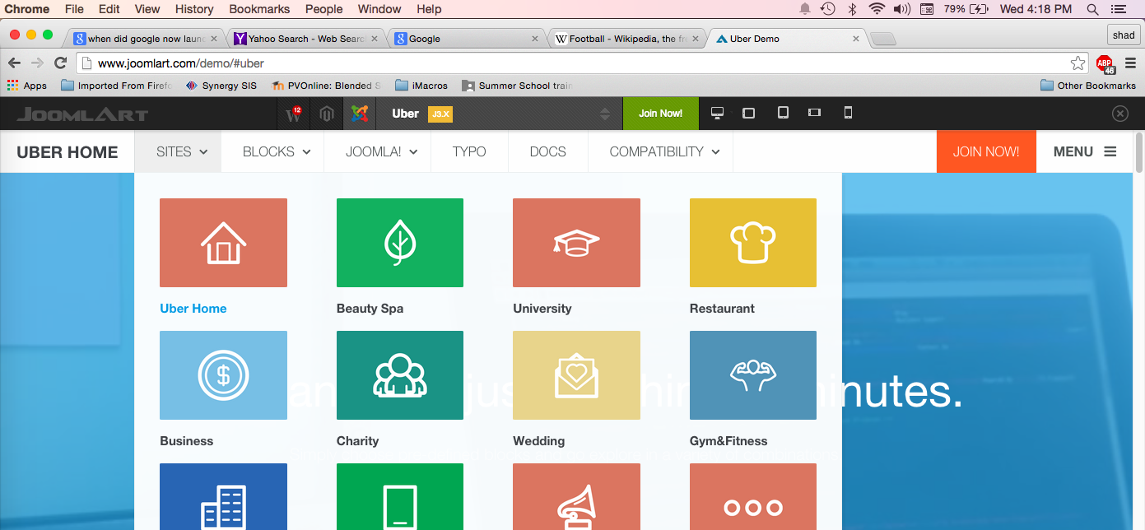
Template Review
Templates are well-designed pre-built websites into which you can put your own content.
Notice the harmony of the color of the various sites they have created.
http://www.joomlart.com/demo/#uber

